Slide 1

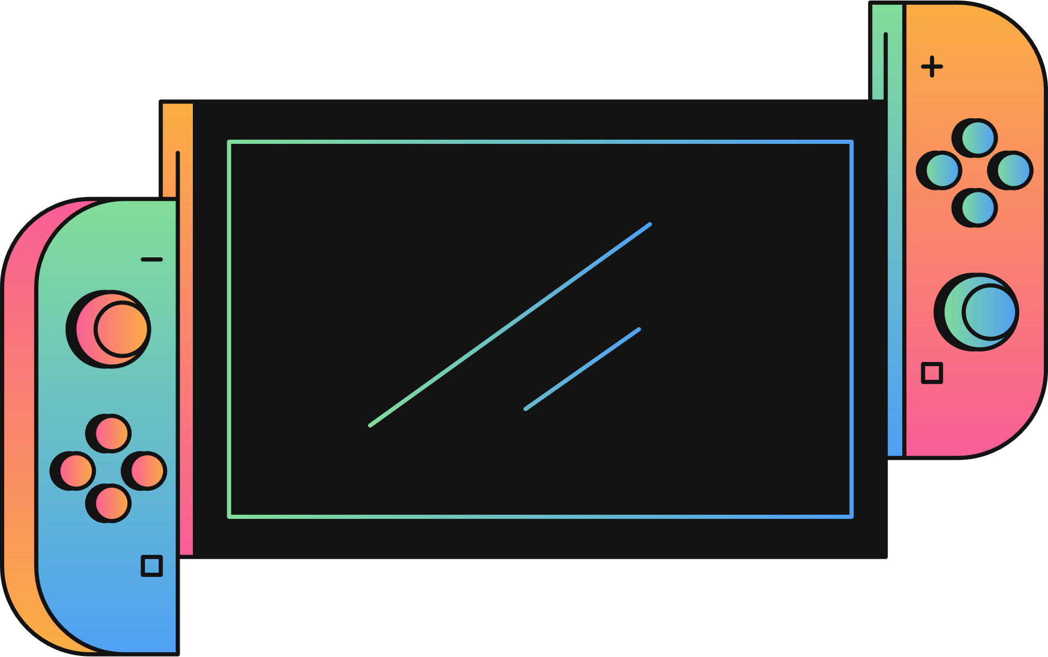
MAPPING THE FUTURE: NAVIGATING NEW DIMENSIONS WITH ARCGIS
SUDHANSHU MUKHERJEE

Slide 2


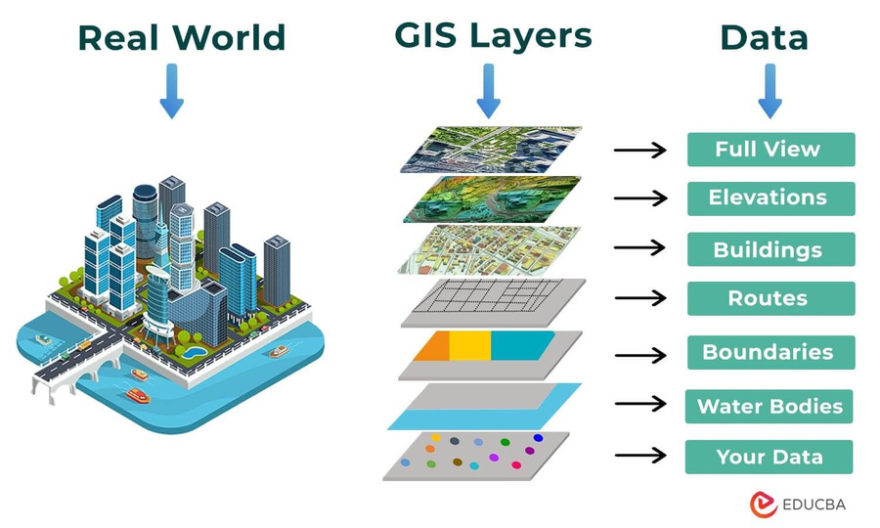
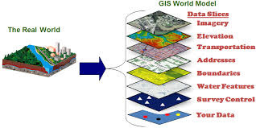
What is GIS?
A geographic information system (GIS) integrates hardware, software, and data for capturing, managing, analyzing, and displaying all forms of geographically referenced information.
GIS allows us to view, understand, question, interpret, and visualize data in many ways that reveal relationships, patterns, and trends in the form of maps, globes, reports, and charts.
A GIS helps you answer questions and solve problems by looking at your data in a way that is quickly understood and easily shared.

Slide 3

So, What can you do with GIS?
Map where this things are
Map Quantities
Map Densities
Map Change
Find what’s inside and what’s nearby
allows analysis of the relationships between layers
Combine Datasets

Slide 4
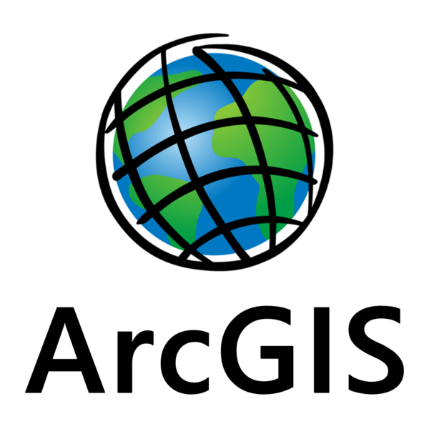
ArcGIS Online
We are going to learn this tool.

